Slide 1

NJ Small Business
Development Centers

Slide 2

Melissa Rosario
Regional Director
NJSBDC at William Paterson University

Slide 3




Who is the ?
The New Jersey Small Business Development Center (NJSBDC) at William Paterson University is one of the NJSBDC network premier providers of comprehensive services, and programs for small- and mid-sized businesses in New Jersey with wide infrastructure, diverse facilities, intellectual and knowledge capabilities, and private sector experts.
28 Years of Service
Serving Passaic County
2 Offices
Supported by:
America’s SBDC New Jersey (NJSBDC) is funded in part through a cooperative agreement with the U.S. Small Business Administration (SBA) and additional support from the New Jersey Business Action Center (BAC), as well as other private sector sponsorships and private/ public grants. All opinions, conclusions or recommendations expressed are those of the author(s) and do not necessarily reflect the views of the SBA. All services are extended to the public on a non-discriminatory basis.

Slide 4

Program/Services
We help small businesses in New Jersey with 3 things:
1. Expert Small Business Consulting, at NO Cost
  Center location in Wayne and Downtown Paterson, NJ
  Specialty Consultants providing accounting, legal, government contracting, business start up, marketing, human resources, accounting etc.
2. Training & Events
  In-Person, Hybrid & Virtual
  Minority Certifications, Procurement Opportunities with the state, public and private entities, Business incorporation, Access to capital and AI etc.
  Industry Specific Programs
  Programs focused on Women, Minority, Veteran and LGBTQ Businesses
Exclusive Small Business Resources
  Networking opportunities
  Market research & analytics
  Referrals

Slide 5

The Impact
NJSBDC Clients Benefit from the NJSBDC
Clients Counseled:
865
Jobs Created:
248
Long Term Clients:
144
Counseling Hours:
2,425.10
New Businesses:
88
Training Events:
47
Capital Infusion:
$7.2M
Training Attendees:
2,042
Certifications:
24
Sales Revenues:
$7,255,919,069
Reflects activities of the NJSBDC network between 1/1/2024– 10/30/2024

Slide 6
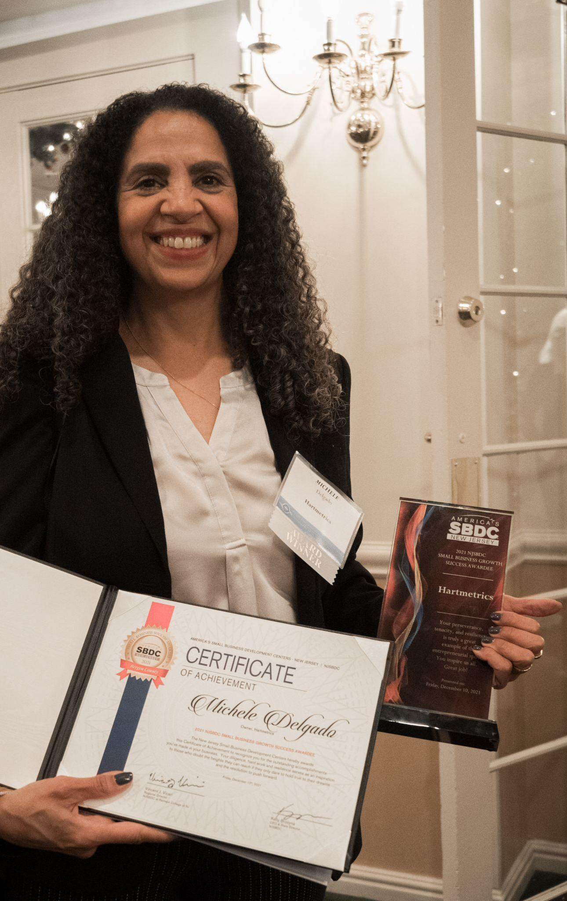
1. Expert Small Business Consulting – At NO Cost
Whether they’re expanding business or starting a new venture, NJSBDC consultants can provide small businesses with personalized guidance on a variety of diverse matters.
1Regional Center
11 Specialty Consultants

Slide 7

2. Comprehensive Training &
Special Events
  NJSBDC Regional Center: In-Person, Hybrid & Virtual throughout the County
  Learning Labs: Certifications, Procurement & MORE
  Industry Specific Programs – Food industry
  Programs focused on Women, Minority, Veteran and LGBTQ Businesses
  Partner Programs & Initiatives

Slide 8
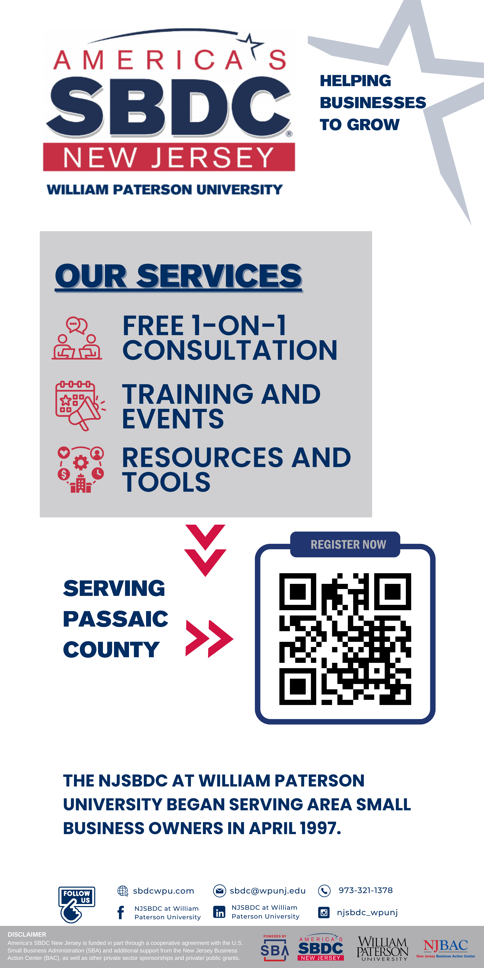
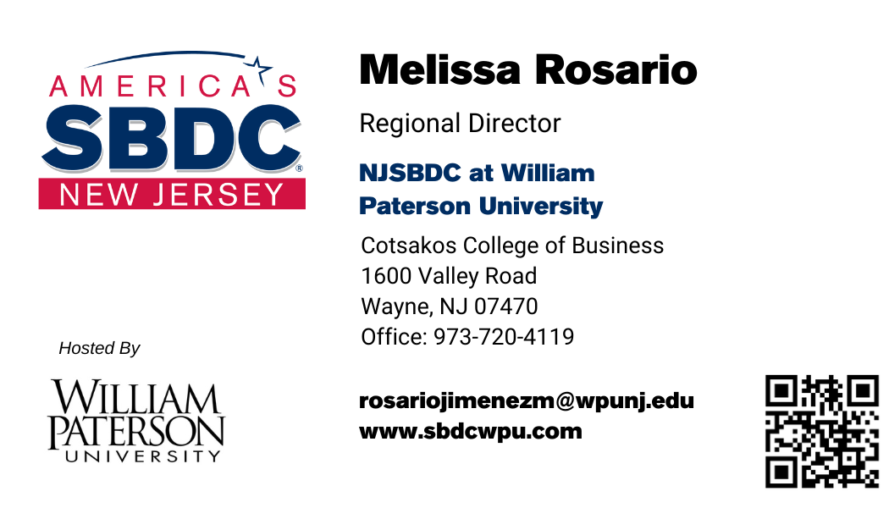
How can you find us?
Upcoming Free or Low-cost Events at NJSBDCWPUNJ.EVENTBRITE.COM

Slide 9
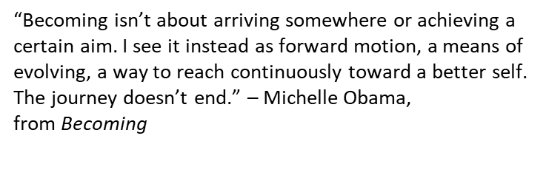
THANK YOU!

